Slide 1

Temporal Difference for Control
Notes:
1

Slide 2
Objectives
Explain how generalized policy iteration can be used with TD to find improved policies
Describe the Sarsa Control algorithm
TD for Control
2
Notes:
2

Slide 3
GPI with Temporal Difference
Generalized Policy Iteration (GPI) is a framework in reinforcement learning that combines policy evaluation and policy improvement in an iterative manner.
It involves continuously alternating between evaluating the current policy and improving it based on the estimated value functions.
Temporal Difference (TD) learning can be integrated into the GPI framework to find improved policies
TD for Control
3
Notes:
3

Slide 4
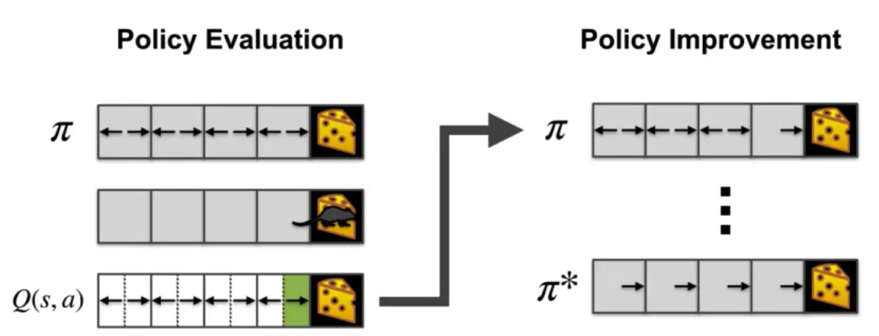
GPI with Temporal Difference
Monte Carlo does not perform a full policy evaluation step before improvement.
Rather, it evaluates and improves after each episode.
We could improve the policy after just one policy evaluation step
TD for Control
4
Notes:
4

Slide 5
SARSA Algorithm
SARSA (State-Action-Reward-State-Action) is a temporal difference learning algorithm commonly used in reinforcement learning.
SARSA is an on-policy algorithm, meaning it learns the value function and policy while following the same policy being evaluated.
SARSA can be used for prediction, which involves estimating the value function Q(s,a), representing the expected cumulative reward starting from state s and taking action a, under a given policy.
TD for Control
5
Notes:
5

Slide 6
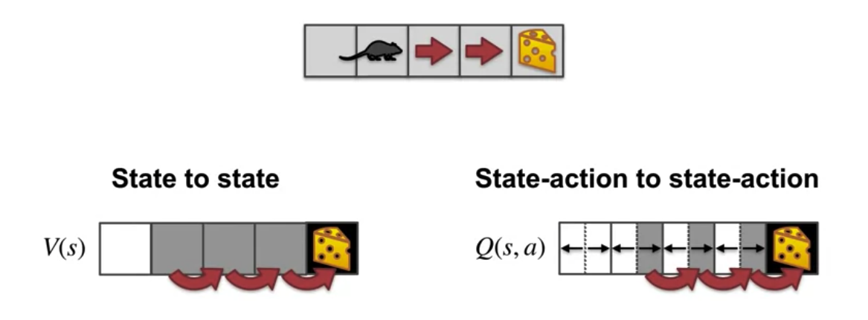
SARSA Algorithm
From state action pair to state action pair and learn the value of each pair
TD for Control
6
Notes:
6

Slide 7
SARSA Algorithm steps
Initialization:
Initialize the state-action value function Q(s,a) arbitrarily for all state-action pairs.
Episodic Interaction:
Interact with the environment by following a policy.
Generate episodes of interaction, where each episode consists of a sequence of state-action-reward-state-action transitions.
TD for Control
7
Notes:
7

Slide 8
SARSA Algorithm
Action Selection:
At each time step t, select an action at in the current state st based on the policy.
This could be an ε-greedy policy, where with probability ε a random action is chosen, and with probability 1−ε the action with the highest value estimate Q(s t ,a) is selected.
TD for Control
8
Notes:
8

Slide 9
SARSA Algorithm
Update Rule: After selecting an action a t and observing the reward r t+1and the next state st+1, update the value estimate for the current state-action pair Q(s t ,at) using the SARSA update rule:
where:
α is the learning rate, controlling the size of the updates
γ is the discount factor, representing the importance of future rewards relative to immediate rewards.
a t+1is the next action chosen in states t+1according to the policy.
TD for Control
9
Notes:
9

Slide 10
SARSA Algorithm
Steps
Set the initial state s.
Choose the initial action a using an epsilon-greedy policy based on the current Q values.
Take the action a and observe the reward r and the next state s’.
Choose the next action a’ using an epsilon-greedy policy based on the updated Q values.
Update the action-value estimate for the current state-action pair using the SARSA update rule:
Q(s, a) = Q(s, a) + alpha * (r + gamma * Q(s’, a’) – Q(s, a))
Repeat steps 4-7 until the episode ends.
TD for Control
10
Notes:
10

Slide 11
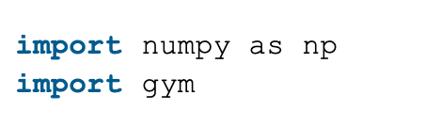
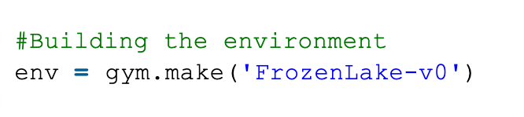
SARSA Algorithm Example code
Step 1: Importing the required libraries
Step 2: Building the environment: using the ‘FrozenLake-v0’ environment which is preloaded into gym
TD for Control
11
Notes:
11

Slide 12
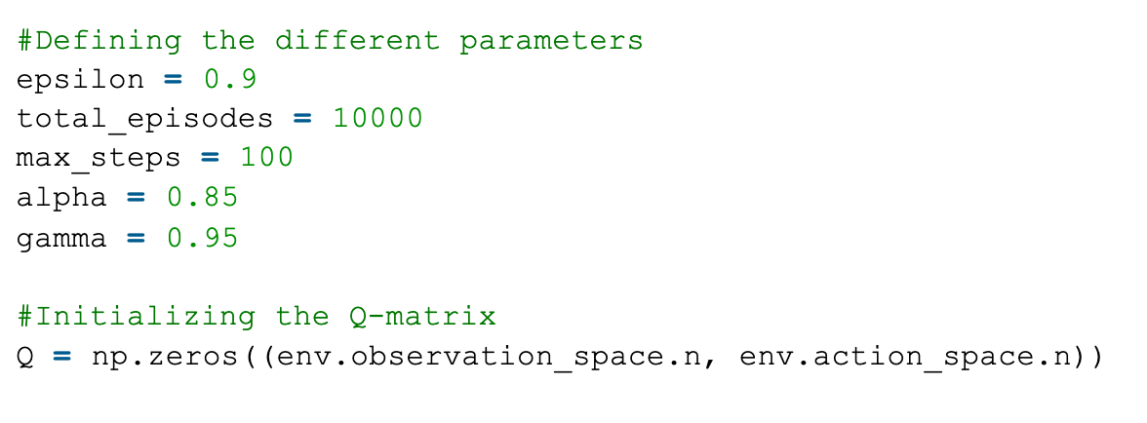
SARSA Algorithm Example code
Step 3: Initializing different parameters
TD for Control
12
Notes:
12

Slide 13
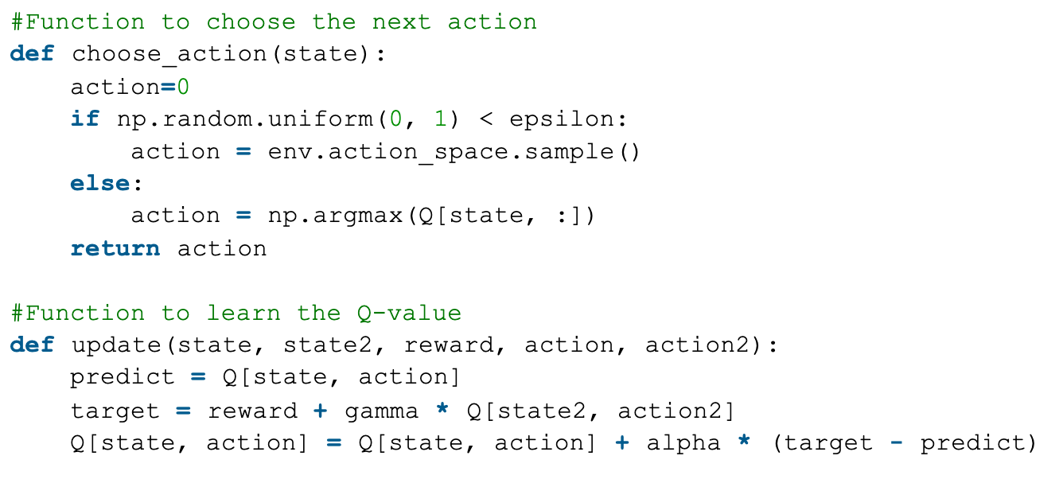
SARSA Algorithm Example code
Step 4: Defining utility functions to be used in the learning process
TD for Control
13
Notes:
13

Slide 14
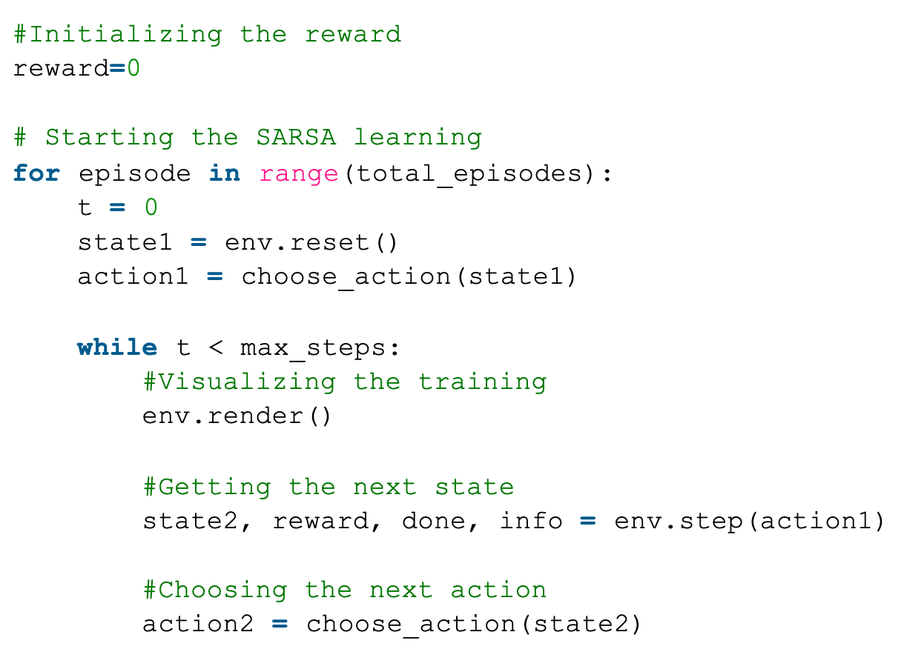
SARSA Algorithm Example code
Step 5: Training the learning agent
TD for Control
14
Notes:
14

Slide 15
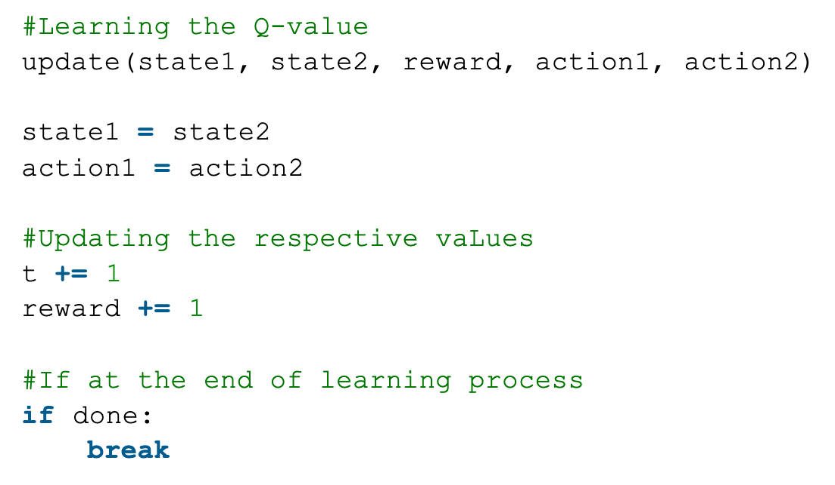
SARSA Algorithm Example code
Step 5: Training the learning agent
TD for Control
15
Notes:
15

Slide 16
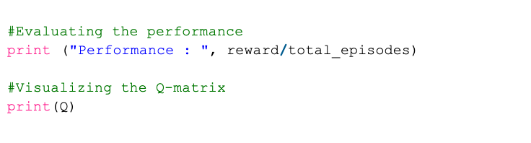
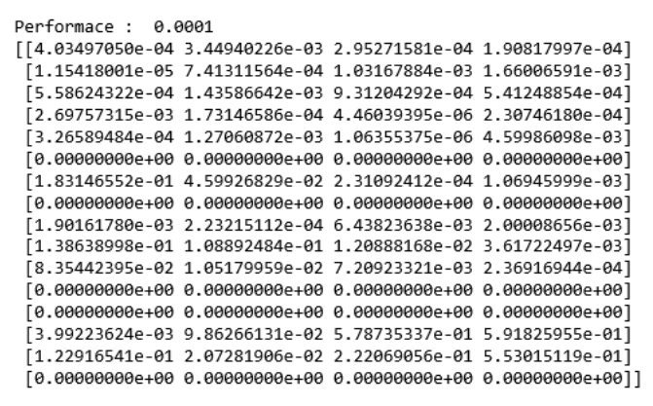
SARSA Algorithm Example code
Step 6: Evaluating the performance
TD for Control
16
Notes:
16

Slide 17
Summary
Explain how generalized policy iteration can be used with TD to find improved policies
Describe the Sarsa Control algorithm
TD for Control
17

Slide 18
Q & A
TD for Control
18

